Slide 1
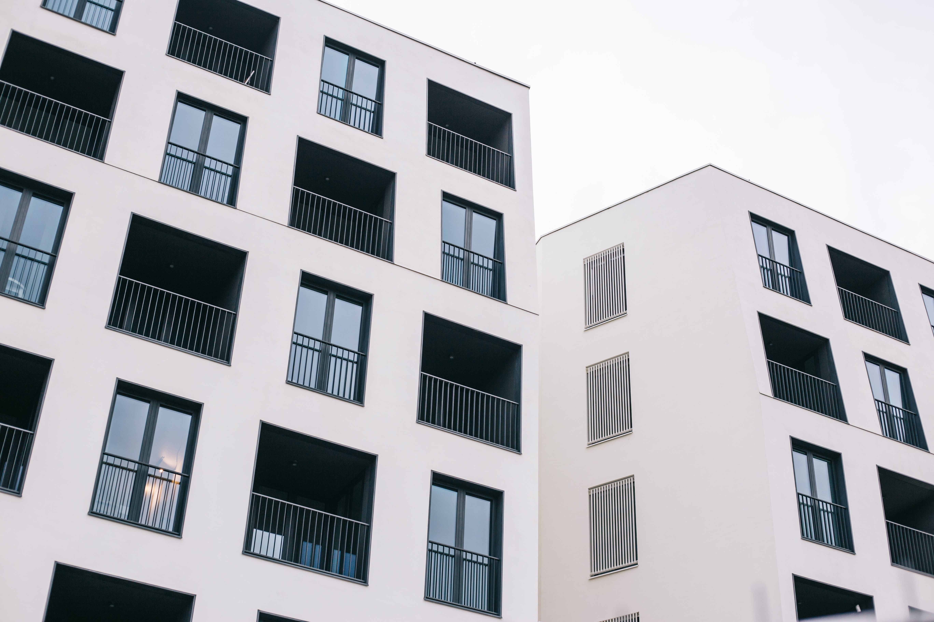
APARTMENT HUNTING
DATA ANALYTICS PROJECT
by SUBRATA MONDAL

Slide 2
PROJECT WORKFLOW
DATA ANALYTICS PROCESS
1
2
3
Plan
Prepare
Process
SOME INFO
SOME INFO
SOME INFO

Slide 3
PROJECT WORKFLOW
DATA ANALYTICS PROCESS
4
5
6
Analyze
Share
Act
SOME INFO
SOME INFO
SOME INFO

Slide 4

PLAN
Before going to the market we need to first decide what do we want. Is it an apartment or house or villa?
Here, we want to buy an apartment for personal space.

Slide 5

PREPARE
Next, we need to check our budget and a way to finance that. For example:
Is the budget above or below 10 lakh 10 crore?
Are we going to use hard cash or take home loans or use EMIs?
Here, our budget ranges from 1 - 2 crore and we are going to use hard cash, 50% before and 50% after.

Slide 6

PROCESS
Now we need to decide what type of apartments do we want. Do we want :
Studio/Micro apartment?
Duplex?
Luxury apartment?
Here, we want a Luxury apartment.

Slide 7

ANALYZE
Now we need to analyze:
Is the apartment worth it?
Is it not too far from my work place?
Are there any market for groceries nearby?
Are there any parks nearby?
Are there any schools or colleges nearby?

Slide 8

SHARE
Now, we need to communicate our thoughts and requirements to the broker.
Here, we need a luxury apartment within a budget of 1-2 crore, it must be nearby my work place and must have a groceries market nearby.

Slide 9

ACT
Finally, we have to act based on the multiple options provided by the broker.
So, after analyzing everything we are going with the apartment that is costing us 80 Lakhs and is satisfying all the criteria.

Slide 10


